Slide 1



Teacher Toolkit
Customizable Classroom Management Tool for Teachers
Presented by: Tech Army

Slide 2


Agenda
Project idea/objective | 3
Features of Project | 4
Advantages | 6
Disadvantges | 7
Output | 8
Conclusion | 9

Slide 3
To develop a customizable, intuitive classroom management tool that streamlines administrative tasks (attendance, homework, announcements, student profiles) for teachers, reducing their workload and improving classroom organization.
Objectives
Back to Agenda

Slide 4







Attendance
Tracking, reports, summaries.
HomeWork
Features
Assignment creation, distribution, grading, tracking.
Announcement
.Creation, distribution (email, in-app), scheduling.
Back to Agenda

Slide 5



StudentProfiles
Information storage, gradebook integration, communication logs.
Features
Dashboard
Customizable view, widgets, quick access.
.
Customization
Branding, layout, notifications, fields, grading scales.
Back to Agenda

Slide 6
Advantages
1
2
3
Increased Efficiency:
Streamlines administrative tasks, saving teachers time and effort. Automated attendance, homework distribution, and grading can significantly reduce workload.
Reduced Paperwork:
Digital tools reduce the need for paper-based records, saving resources and reducing environmental impact.
Better Data Management: Centralized data storage improves data accuracy and accessibility. Reports and analytics can provide valuable insights into student performance and classroom trends.

Slide 7
Disadvantages
1
2
3
Development Cost and Time: Creating a robust and customizable tool requires significant investment in development time and resources.
Data Security and Privacy Concerns:
Storing sensitive student data online raises concerns about data security and privacy. Robust security measures are essential to protect this information.
Maintenance and Updates:
The tool requires ongoing maintenance, updates, and bug fixes, which can add to the long-term cost.

Slide 8
OUTPUT

Slide 9
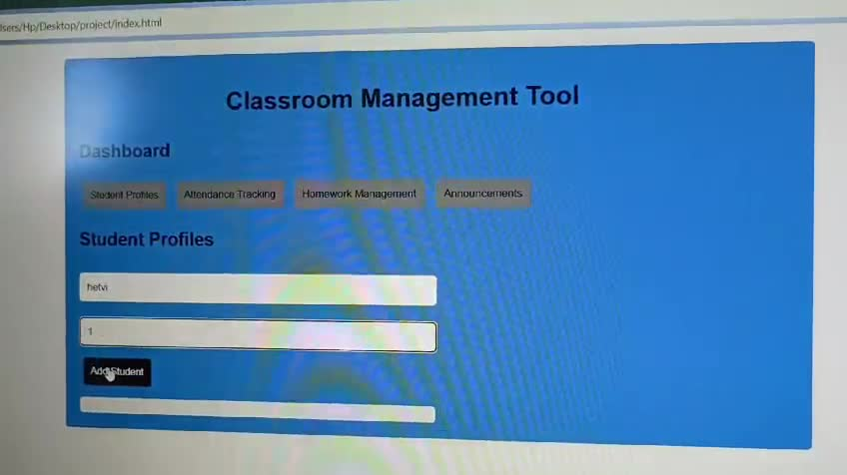
Output for Frontend

Slide 10
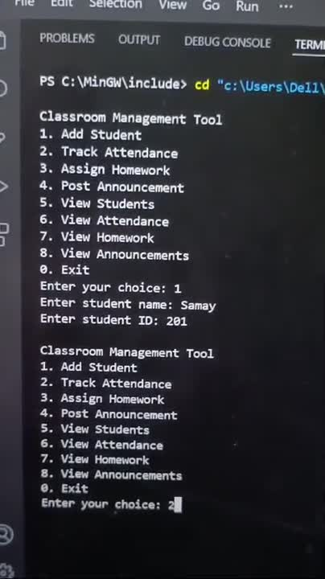
Output for Backend

Slide 11
This project will deliver a customizable classroom management tool for teachers, simplifying attendance, homework, announcements, and student profile management. While initially excluding external integrations and mobile access, it provides a foundation for future enhancements, ultimately aiming to improve teacher efficiency and classroom organization.
Conclusion

Slide 12
Our Team
Aman Khimani
Hetvi Magiya
Adib Puthawala
Srushti Kale

Slide 13


